Slide 1

Principles of Economics
Swagat Kishore Mishra
Lecturer, Dept. of Economics
Email: swagat@bits-goa.ac.in / sayswagat@gmail.com
VOIP: 207 PSRN: 485 CHAMBER: A-301/16
Tel. 0832-2580207 (O) 08879506995 (M)
Lecture-4

Slide 2

Elasticity of Demand (Supply)
The slope of a linear demand curve is constant, but its elasticity is not.
The price elasticity of demand determines whether the demand curve is steep or flat.
The price elasticity of supply determines whether the supply curve is steep or flat.

Slide 3
Price elasticity
It refers to a measure of strength of Buyers or Sellers response to a price change.
Price Elastic: a strong response to price change occurs when the percentage change in quantity demanded or supplied is GREATER than the percentage change in price.
Price Inelastic: a weak response to a price change occurs when the percentage change in quantity demanded or supplied is LESS than the percentage change in price.

Slide 4
Total Revenue
When demand is elastic, TR moves in OPPOSITE direction of price change.
When demand is inelastic, TR moves in the SAME direction as the price change.
ELASTIC | INELASTIC
TR and P move in opposite direction | TR and P move in same direction

Slide 5
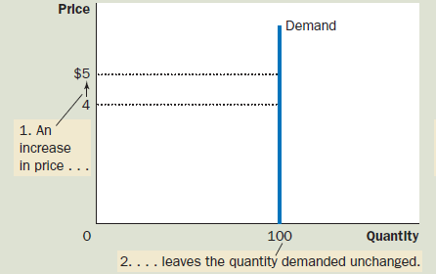
(a) Perfectly Inelastic Demand: Elasticity Equals ‘0’ (Zero)

Slide 6
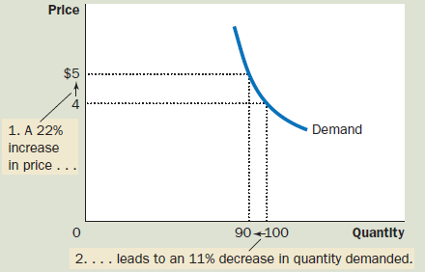
(b) Inelastic Demand: Elasticity Is Less Than 1
Approximates for Price/Quantity Rise and Fall

Slide 7
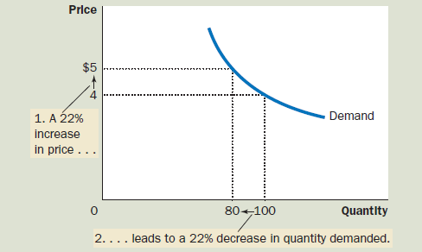
(c) Unit Elastic Demand: Elasticity Equals 1
Approximates for Price/Quantity Rise and Fall

Slide 8
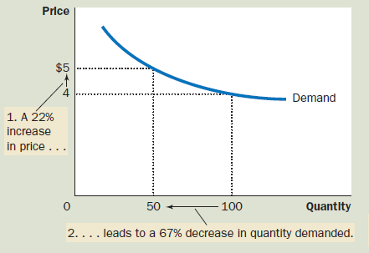
(d) Elastic Demand: Elasticity Is Greater Than 1
Approximates for Price/Quantity Rise and Fall

Slide 9
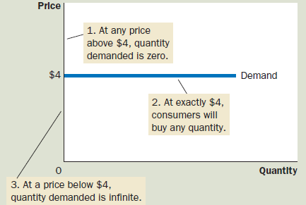
(e) Perfectly Elastic Demand: Elasticity Equals Infinity

Slide 10
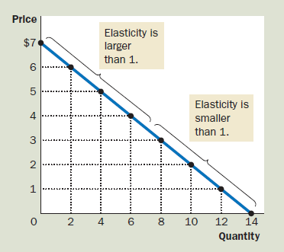
Elasticity of a Linear Demand Curve

Slide 11

Income Elasticity of Demand:
Normal goods have positive income elasticities and
Inferior goods have negative income elasticities.
“A measure of how much the quantity demanded of a good responds to a change in consumers’ income, computed as the percentage change in quantity demanded divided by the percentage change in income”

Slide 12
The Cross-Price Elasticity of Demand
“A measure of how much the quantity demanded of one good responds to a change in the price of another good, computed as the percentage change in quantity demanded of the first good divided by the percentage change in the price of the second good.”

Slide 13
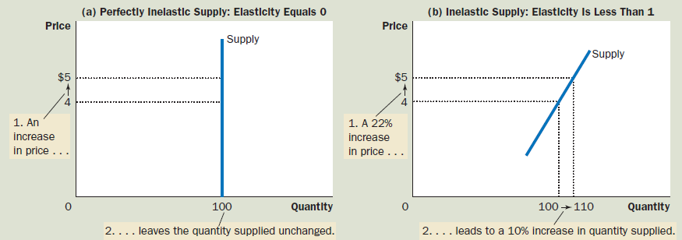
Elasticity of Supply
Approximates for Price/Quantity Rise and Fall

Slide 14
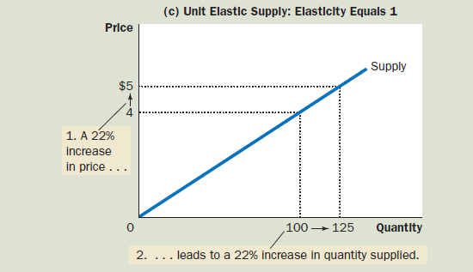
Approximates for Price/Quantity Rise and Fall

Slide 15
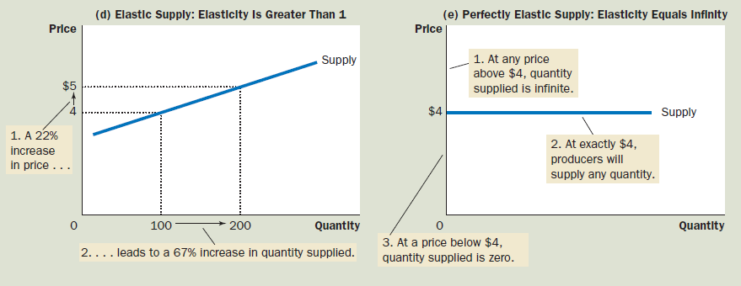
Approximates for Price/Quantity Rise and Fall

Slide 16
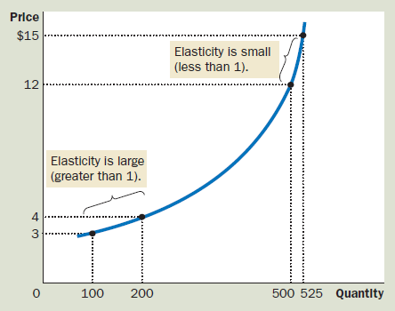

Slide 17


Price elastic
Price
EXAMPLE A
This shows the demand curve for ice-cream where the quantity demanded changes greatly with a fairly poor price change, indicating that the demand for ice-cream is elastic. A 1% rise in price leads to a 2% fall in quantity demanded.
Demand for ice-cream
2.10
2.00
Quantity
90
100

Slide 18
Price inelastic
Price
Demand for milk
EXAMPLE B
This shows the demand curve for milk where the quantity demanded changes very little regardless of price change, meaning that the demand for ice-cream is elastic. A 1% rise in price leads to a 0.2% fall in quantity demanded.
2.10
2.00
Quantity
99
100

Slide 19
Comparing Elasticities
Price
Less elastic demand curve (Steeper)
At the Point of intersection Flatter D-curve has greater Elasticity
More elastic demand curve
(Flatter)
Quantity

Slide 20
Changing Elasticity along a demand curve
Price
At this point, demand curve is
quite seep and inelastic.
Demand curve for Aluminium
At this point, demand curve
is very flat and elastic.
Quantity

Slide 21
Elasticity of Demand over time
Price
Short-run demand for gasoline
Since there is less time to adapt to the price
changes, the curve is less elastic in the short-run,
but more elastic in the long run.
Long-run demand for
gasoline
Quantity

Slide 22


Changing elasticity along a Supply curve
Price
Full capacity region
When output is low and many machines are idle, a small change in price can lead to a large increase in quantity produced, so the curve is flat and elastic.
When output is high and all machines are working close to their limit, it takes a very large price change to induce even a small change in output, hence the curve is steep and inelastic
Excess capacity region
Quantity

Slide 23
Elasticity of supply over time
Price
Short-run supply of soybean
(inelastic)
Long-run supply of soybean
(elastic)
Quantity

Slide 24
Contents
Practice Set 1

Slide 25
Q1. Categorise the following statements under
Positive (P) or Normative (N) thoughts. (3 min)
Higher interest rates causes people to save more.
Governments must tax the rich to help poor.
Road use charges would increase tariffs.
Smoking should be discouraged.
Burning of fossil fuel causes global warming.

Slide 26


Q2. The figure suggests that shifting of demand curve a. from D0 to D1 indicates increase in demand b. from D0 to D2 indicates a decrease in demand (4 min)
An increase in demand can be caused by a rise in price of a …….., a fall in the price of a …….., and a rise in income.
(compliment, substitute)
b. A decrease in demand can be caused by a fall in the price of a ……, a rise in the price of ……. and a fall in income.
(compliment, substitute)
Y
D0
D1
D2
X
0

Slide 27
Q3. State TRUE or FALSE (5 min)
When supply exceeds demand the market price will fall.
When demand exceeds supply the market price will rise.
Inferior goods have positive income elasticity of demand.
Engel curve establishes relationship between income level and food consumption.
Unitary elasticity is found on the mid-point of a linear supply function.

Slide 28
Q4. Draw a demand curve for the same data set of prices by implementing scales as in two figures: Interpret your understanding. (6 min)
P | 25 | 20 | 15 | 5
Q | 50 | 150 | 250 | 650
P
P
25
50
20
40
15
30
20
10
10
05
Q
Q
0
100
200
300
400
500
600
0
200
400
600
800
1000

Slide 29
Q5. Label the 3 demand functions as: zero elasticity (D1), infinite elasticity (D2)and unit elasticity (D3). (3 min)
price
quantity
0

Slide 30
Q6. Match the 5 economic terms to fill in the gaps: (5 min) p/q constant zero infinity slope
“Moving from A to B, the ratio dp/dq is the ……. of the line, while its reciprocal dq/dp is the first term in the percentage definition of elasticity.
The second term is p/q which is ratio of co-ordinates of point A.
Since the slope dp/dq is……. the elasticity along the curve varies with the ratio ……… which is …….where the curve intersects the quantity axis and ……. where it intersects the price axis.”
P
D
B
dp
A
p
dq
Q
O
q

Slide 31
PROBLEM 1
Given the supply function: q = 10p³ – 1000
  Find the arc elasticity of supply when p increases from 10 to 11.
  Find the point elasticity when p=10.
Hint: Definitions of elasticity of supply are given as,
  Arc elasticity: E^{s}_{A}=( Δq/Δp )*(p₀/q₀)
  Point elasticity: E^{S}=(dq/dp)*(p₀/q₀)

Slide 32
PROBLEM 2
Given the demand function q= 100 - 5p
Find the price elasticity when p increases
  From 5 to 6
  From 13 to 14
Find the point elasticity
  When p=5
  When p=13

Slide 33
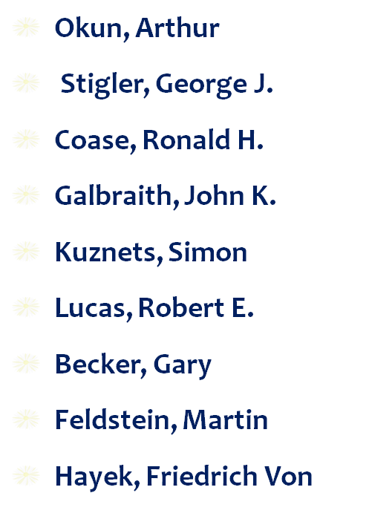
ECONOMISTS for POE
Keynes, John Maynard
Smith, Adam
Friedman, Milton
Ricardo, David
Marx, Karl
Malthus, Thomas
Marshall, Alfred
Schumpeter, Joseph

Slide 34
Thanking
BITS PILANI, K.K.BIRLA GOA CAMPUS
Under the aegis of
Department of Economics
Dr. Mridula Goel (HOD)
Dr. Debashish Pattanaik
Dr. Aswini Kumar Mishra
Dr. Kubendran N.
Dr. Indranil De
Ms. Ambili K.
Mr. Swagat Kishore Mishra

